Slide 1
Introduction to Computer Networks
INTRODUCTION TO COMPUTER NETWORKS

Slide 2
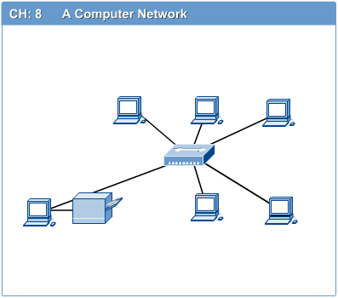
Computer Networks
Introduction to Computer Networks
Computer network connects two or more autonomous computers.
The computers can be geographically located anywhere.
Notes:
LAN , MAN and WAN

Slide 3
LAN, MAN & WAN
Introduction to Computer Networks
Network in small geographical Area (Room, Building or a Campus) is called LAN (Local Area Network)
Network in a City is call MAN (Metropolitan Area Network)
Network spread geographically (Country or across Globe) is called WAN (Wide Area Network)

Slide 4
Applications of Networks
Introduction to Computer Networks
Resource Sharing
  Hardware (computing resources, disks, printers)
  Software (application software)
Information Sharing
  Easy accessibility from anywhere (files, databases)
  Search Capability (WWW)
Communication
  Email
  Message broadcast
Remote computing
Distributed processing (GRID Computing)

Slide 5
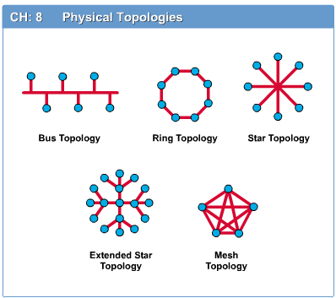
Network Topology
Introduction to Computer Networks
The network topology defines the way in which computers, printers, and other devices are connected. A network topology describes the layout of the wire and devices as well as the paths used by data transmissions.

Slide 6
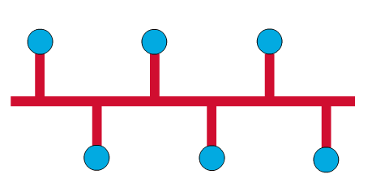
Bus Topology
Introduction to Computer Networks
Commonly referred to as a linear bus, all the devices on a bus topology are connected by one single cable.

Slide 7
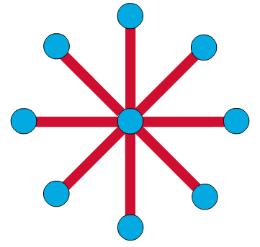
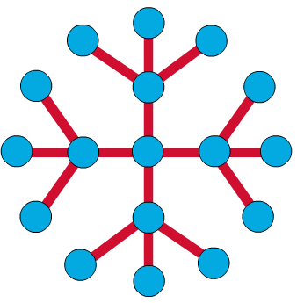
Star & Tree Topology
Introduction to Computer Networks
The star topology is the most commonly used architecture in Ethernet LANs.
When installed, the star topology resembles spokes in a bicycle wheel.
Larger networks use the extended star topology also called tree topology. When used with network devices that filter frames or packets, like bridges, switches, and routers, this topology significantly reduces the traffic on the wires by sending packets only to the wires of the destination host.

Slide 8
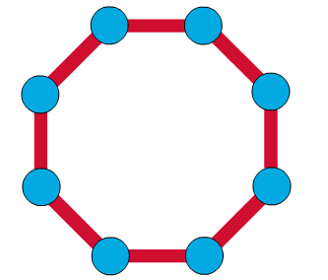
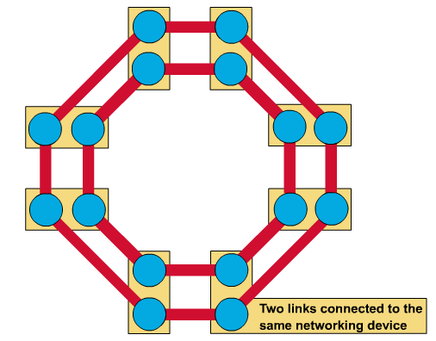
Ring Topology
Introduction to Computer Networks
A frame travels around the ring, stopping at each node. If a node wants to transmit data, it adds the data as well as the destination address to the frame.
The frame then continues around the ring until it finds the destination node, which takes the data out of the frame.
  Single ring – All the devices on the network share a single cable
  Dual ring – The dual ring topology allows data to be sent in both directions.

Slide 9
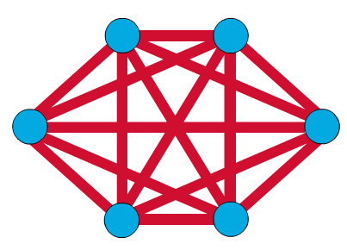
Mesh Topology
Introduction to Computer Networks
The mesh topology connects all devices (nodes) to each other for redundancy and fault tolerance.
It is used in WANs to interconnect LANs and for mission critical networks like those used by banks and financial institutions.
Implementing the mesh topology is expensive and difficult.
Notes:
N(n-1)/2=

Slide 10
Network Components
Introduction to Computer Networks
Physical Media
Interconnecting Devices
Computers
Networking Software
Applications

Slide 11
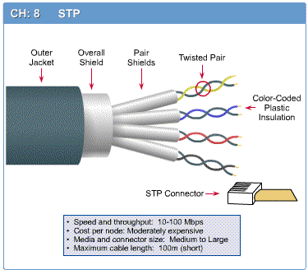
Networking Media
Introduction to Computer Networks
Networking media can be defined simply as the means by which signals (data) are sent from one computer to another (either by cable or wireless means).

Slide 12
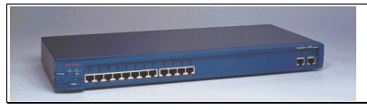
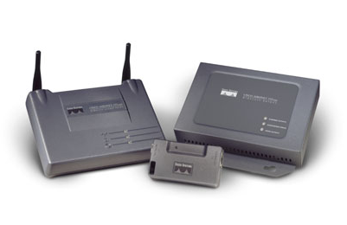
Networking Devices
Introduction to Computer Networks
HUB, Switches, Routers, Wireless Access Points, Modems etc.

Slide 13
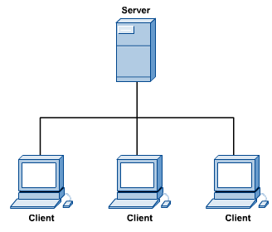
Computers: Clients and Servers
Introduction to Computer Networks
In a client/server network arrangement, network services are located in a dedicated computer whose only function is to respond to the requests of clients.
The server contains the file, print, application, security, and other services in a central computer that is continuously available to respond to client requests.

Slide 14
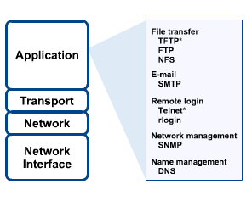
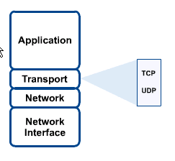
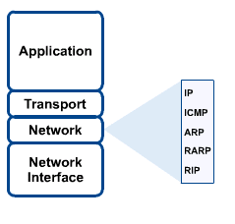
Networking Protocol: TCP/IP
Introduction to Computer Networks

Slide 15

Applications
Introduction to Computer Networks
E-mail
Searchable Data (Web Sites)
E-Commerce
News Groups
Internet Telephony (VoIP)
Video Conferencing
Chat Groups
Instant Messengers
Internet Radio

Slide 16

Chapter 2
The OSI Model and
the TCP/IP Protocol Suite
Objectives
Upon completion you will be able to:
Understand the architecture of the OSI model
Understand the layers of the OSI model and their functions
Understand the architecture of the TCP/IP Protocol Suite
Differentiate between the OSI model and the TCP/IP Suite
Differentiate between the three types of Internet addresses
TCP/IP Protocol Suite

Slide 17
2.1 The OSI Model
Established in 1947, the International Standards Organization (ISO) is a multinational body dedicated to worldwide agreement on international standards. An ISO standard that covers all aspects of network communications is the Open Systems Interconnection (OSI) model. It was first introduced in the late 1970s.
The topics discussed in this section include:
Layered Architecture
Peer-to-Peer Processes
Encapsulation
TCP/IP Protocol Suite

Slide 18

Note:
ISO is the organization.
OSI is the model
TCP/IP Protocol Suite

Slide 19
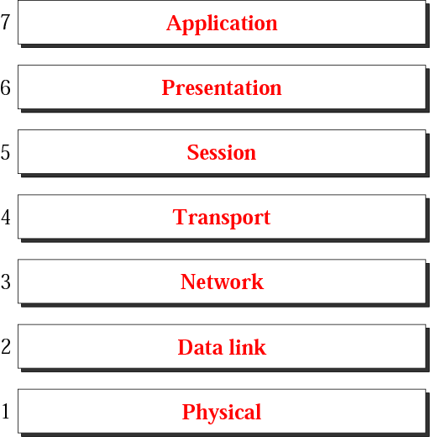
Figure 2.1 The OSI model
TCP/IP Protocol Suite
Notes:
Application , Transport, Internet layer, Host layer (Data, phy )

Slide 20
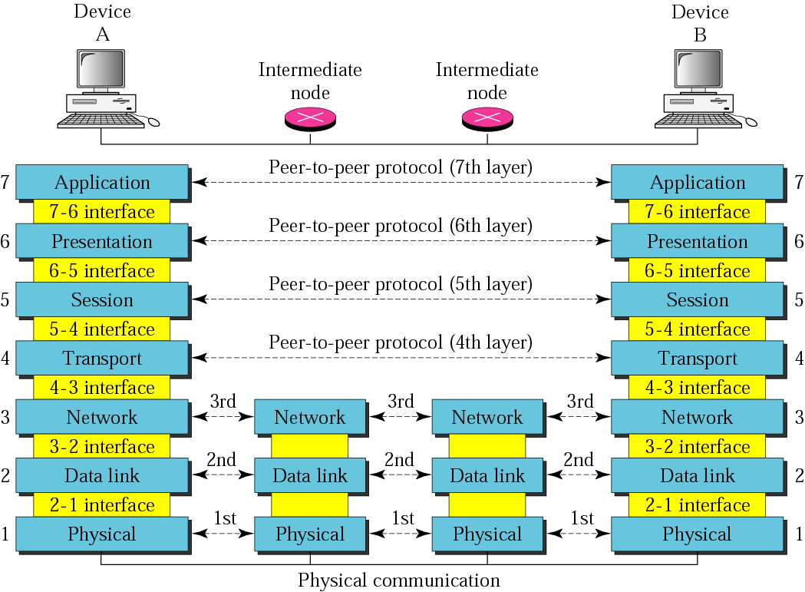
Figure 2.2 OSI layers
TCP/IP Protocol Suite

Slide 21
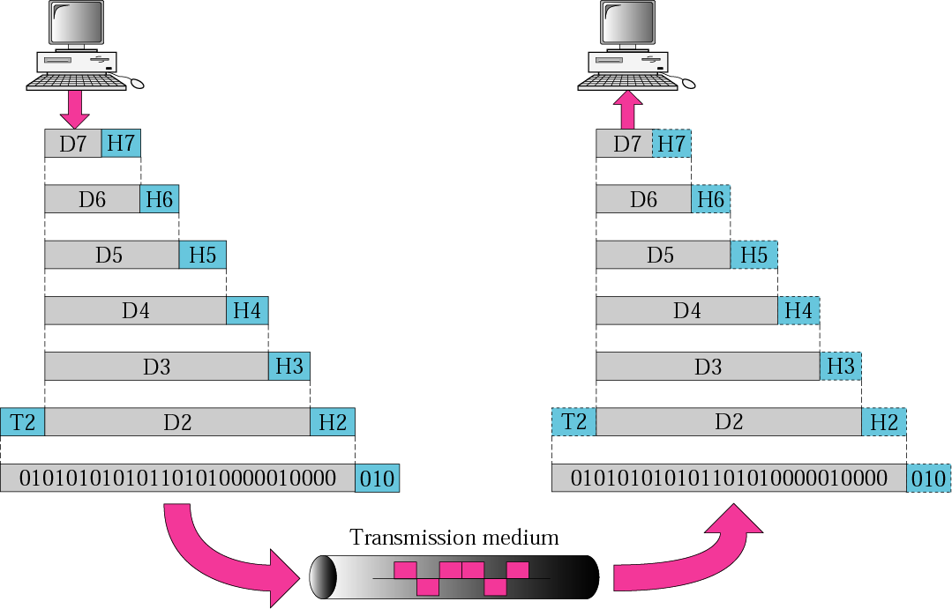
Figure 2.3 An exchange using the OSI model
TCP/IP Protocol Suite

Slide 22
2.2 Layers in the OSI Model
The functions of each layer in the OSI model is briefly described.
The topics discussed in this section include:
Physical Layer
Data Link Layer
Network Layer
Transport Layer
Session Layer
Presentation Layer
Application Layer
Summary of Layers
TCP/IP Protocol Suite

Slide 23
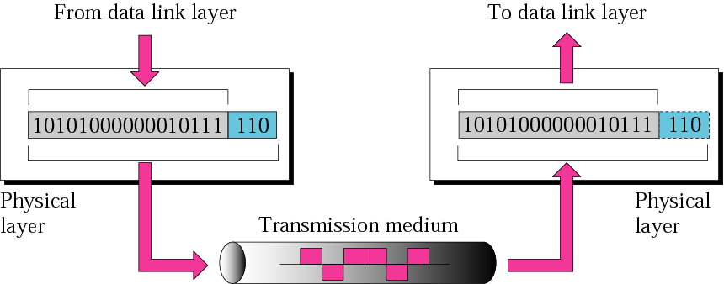
Figure 2.4 Physical layer
TCP/IP Protocol Suite
Notes:
Physical characteristics of interfaces, Representation of bits, Data rate, Synchronization of bits , Line configuration , Physical topology and Transmission mode.

Slide 24
Note:
The physical layer is responsible
for the movement of individual bits from one hop (node) to the next.
TCP/IP Protocol Suite

Slide 25
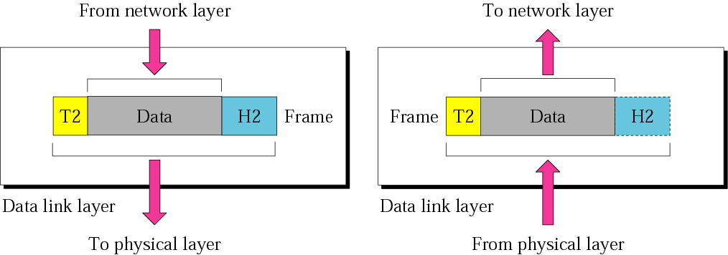
Figure 2.5 Data link layer
TCP/IP Protocol Suite

Slide 26
Note:
The data link layer is responsible for moving frames from one hop (node) to the next.
TCP/IP Protocol Suite

Slide 27
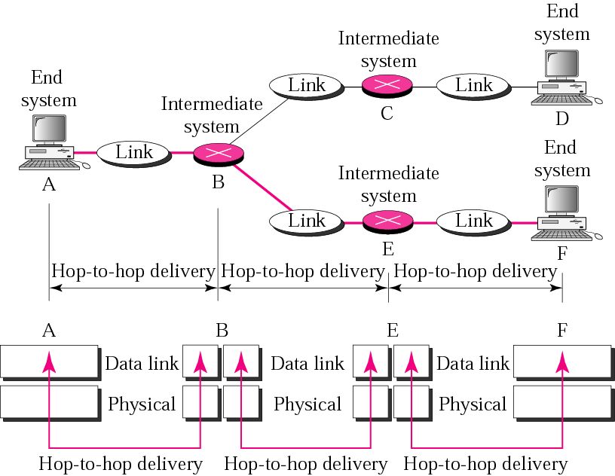
Figure 2.6 Hop-to-hop delivery
TCP/IP Protocol Suite

Slide 28
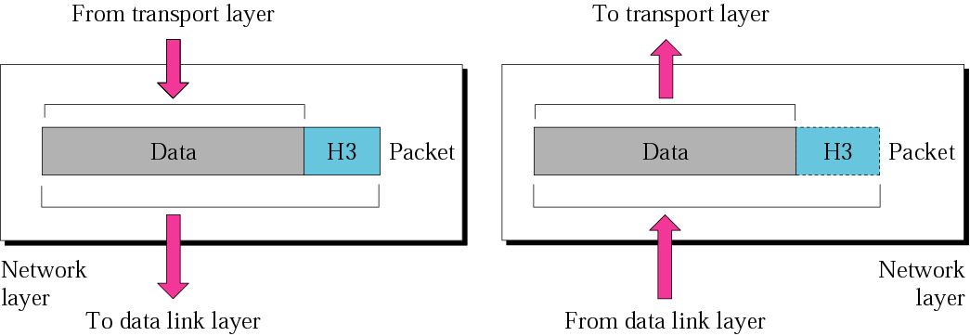
Figure 2.7 Network layer
TCP/IP Protocol Suite

Slide 29
Note:
The network layer is responsible for the delivery of individual packets from the source host to the destination host.
TCP/IP Protocol Suite

Slide 30
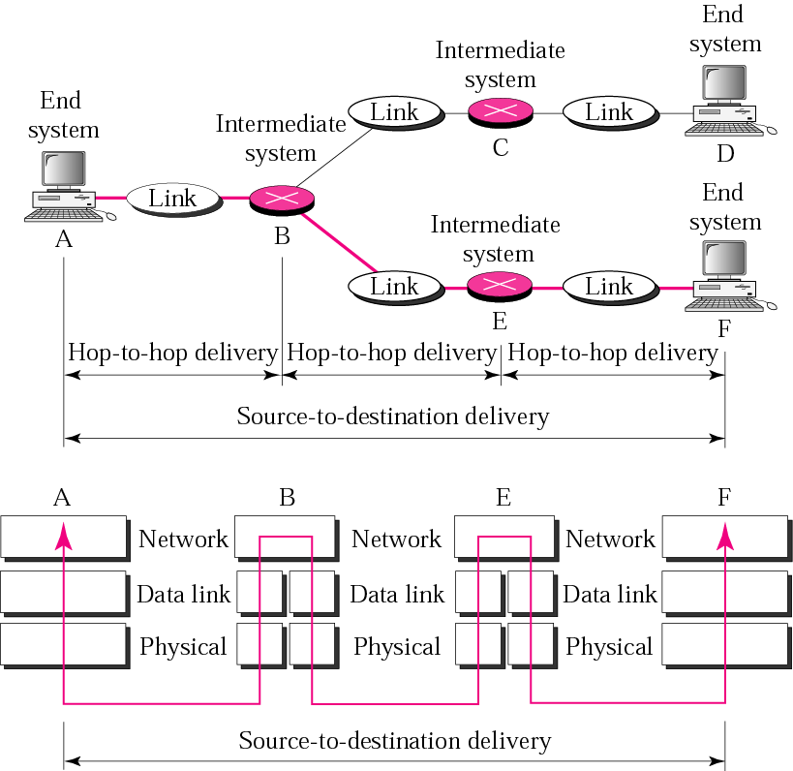
Figure 2.8 Source-to-destination delivery
TCP/IP Protocol Suite

Slide 31
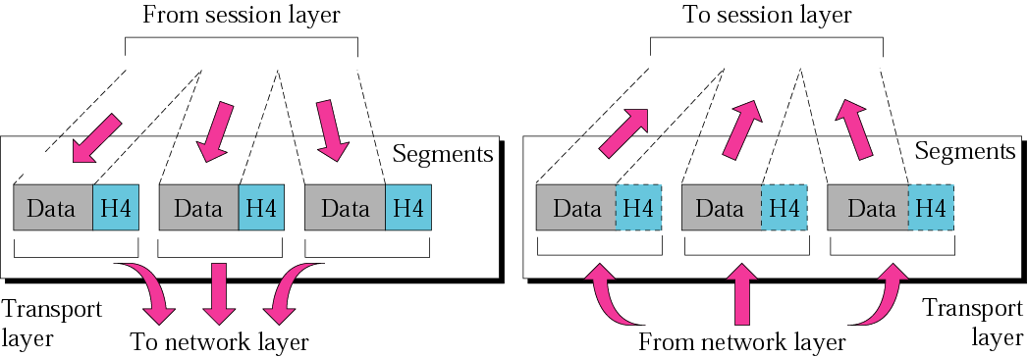
Figure 2.9 Transport layer
TCP/IP Protocol Suite

Slide 32
Note:
The transport layer is responsible for the delivery of a message from one process to another.
TCP/IP Protocol Suite

Slide 33
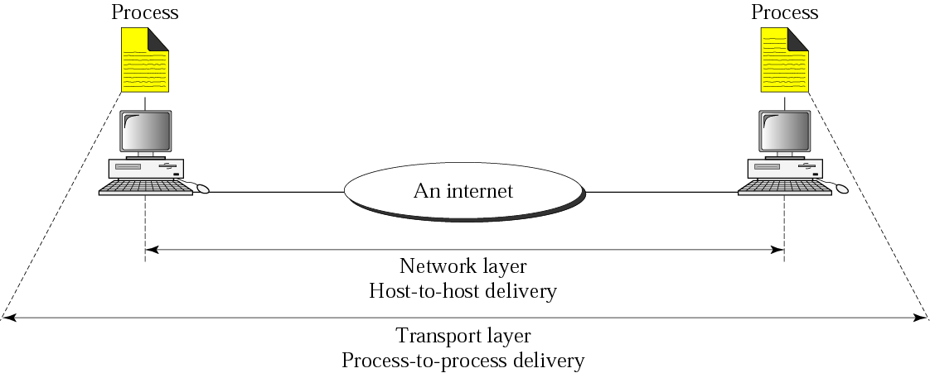
Figure 2.10 Reliable process-to-process delivery of a message
TCP/IP Protocol Suite

Slide 34
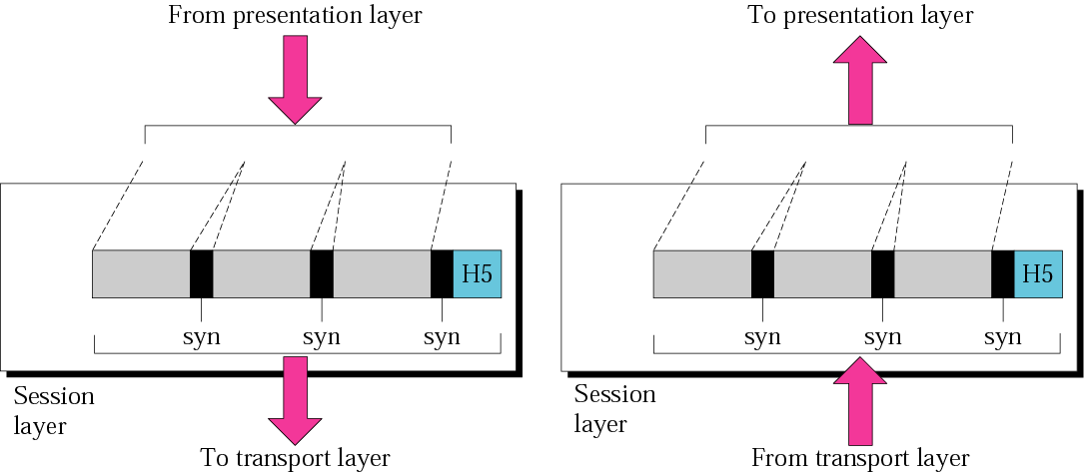
Figure 2.11 Session layer
TCP/IP Protocol Suite

Slide 35
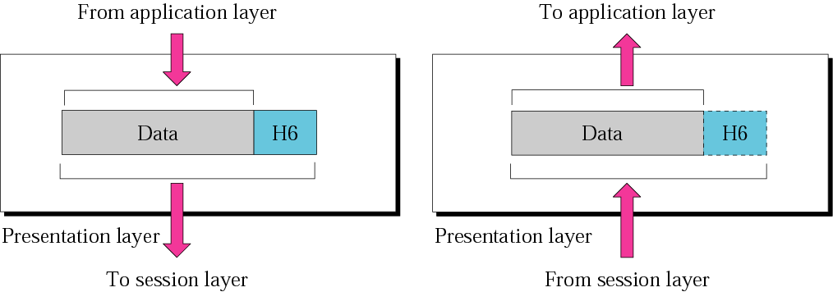
Figure 2.12 Presentation layer
TCP/IP Protocol Suite

Slide 36
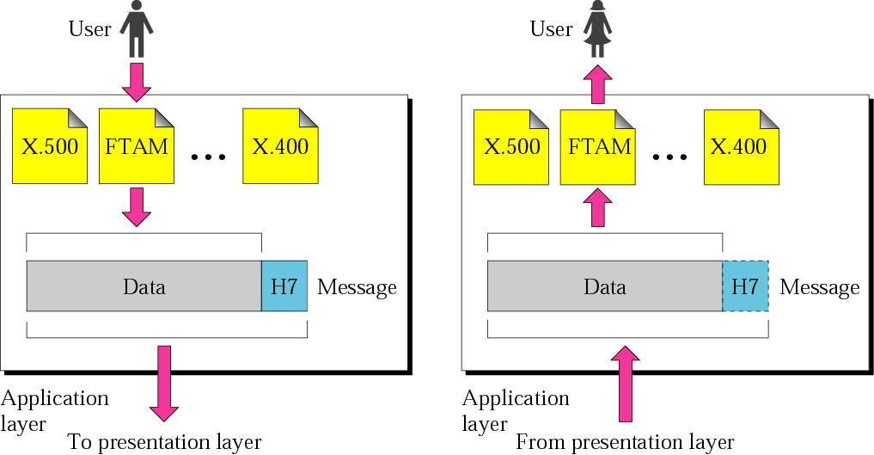
Figure 2.13 Application layer
TCP/IP Protocol Suite

Slide 37
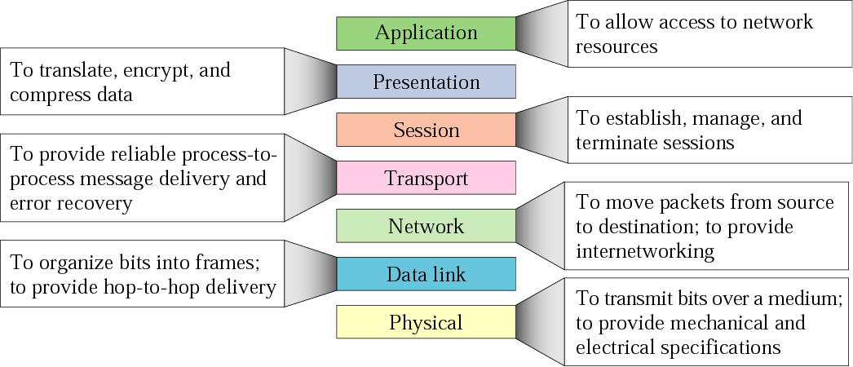
Figure 2.14 Summary of layers
TCP/IP Protocol Suite

Slide 38
2.3 TCP/IP Protocol Suite
The TCP/IP protocol suite is made of five layers: physical, data link, network, transport, and application. The first four layers provide physical standards, network interface, internetworking, and transport functions that correspond to the first four layers of the OSI model. The three topmost layers in the OSI model, however, are represented in TCP/IP by a single layer called the application layer.
The topics discussed in this section include:
Physical and Data Link Layers
Network Layer
Transport Layer
Application Layer
TCP/IP Protocol Suite

Slide 39
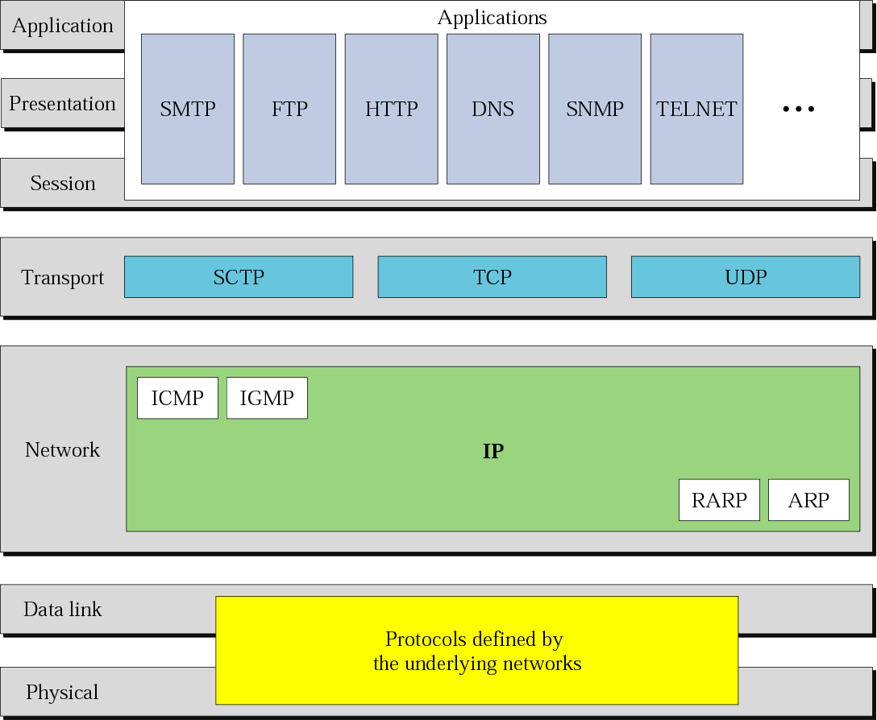
Figure 2.15 TCP/IP and OSI model
TCP/IP Protocol Suite

Slide 40
2.4 Addressing
Three different levels of addresses are used in an internet using the TCP/IP protocols: physical (link) address, logical (IP) address, and
port address.
The topics discussed in this section include:
Physical Address
Logical Address
Port Address
TCP/IP Protocol Suite

Slide 41
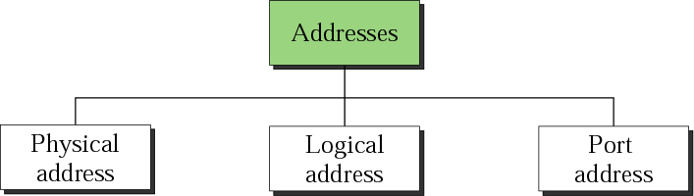
Figure 2.16 Addresses in TCP/IP
TCP/IP Protocol Suite

Slide 42
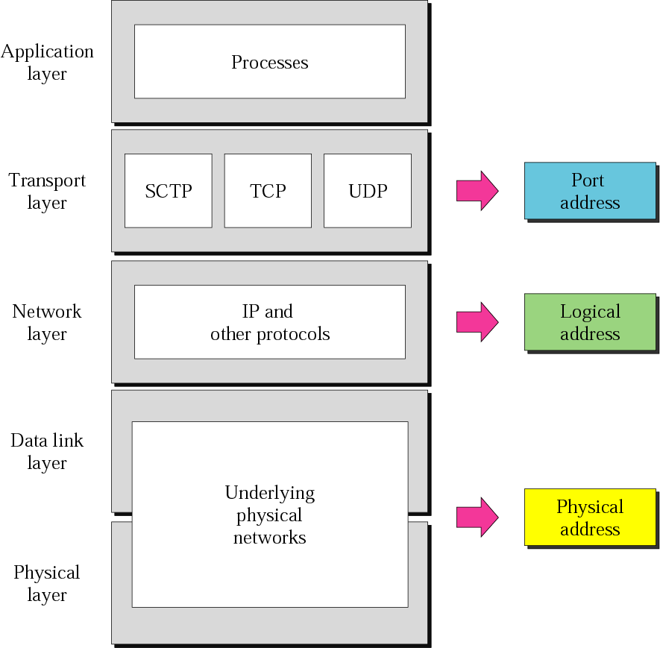
Figure 2.17 Relationship of layers and addresses in TCP/IP
TCP/IP Protocol Suite

Slide 43
Example 1
In Figure 2.18 a node with physical address 10 sends a frame to a node with physical address 87. The two nodes are connected by a link. At the data link level this frame contains physical (link) addresses in the header. These are the only addresses needed. The rest of the header contains other information needed at this level. The trailer usually contains extra bits needed for error detection.
See Next Slide
TCP/IP Protocol Suite

Slide 44
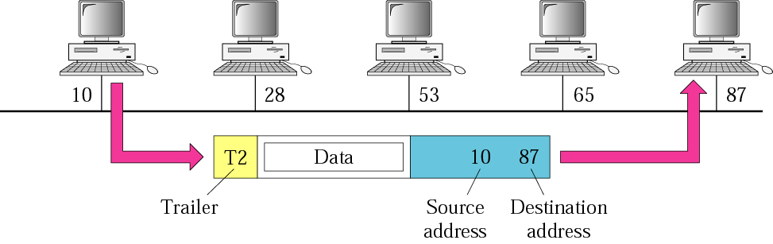
Figure 2.18 Physical addresses
TCP/IP Protocol Suite

Slide 45
Example 2
As we will see in Chapter 3, most local area networks use a 48-bit (6 bytes) physical address written as 12 hexadecimal digits, with every 2 bytes separated by a colon as shown below:
07:01:02:01:2C:4B
A 6-byte (12 hexadecimal digits) physical address.
TCP/IP Protocol Suite

Slide 46
Example 3
In Figure 2.19 we want to send data from a node with network address A and physical address 10, located on one LAN, to a node with a network address P and physical address 95, located on another LAN. Because the two devices are located on different networks, we cannot use link addresses only; the link addresses have only local jurisdiction. What we need here are universal addresses that can pass through the LAN boundaries. The network (logical) addresses have this characteristic.
See Next Slide
TCP/IP Protocol Suite

Slide 47
Example 3 (Continued)
The packet at the network layer contains the logical addresses, which remain the same from the original source to the final destination (A and P, respectively, in the figure). They will not change when we go from network to network. However, the physical addresses will change as the packet moves from one network to another. The boxes labeled routers are internetworking devices, which we will discuss in Chapter 3.
See Next Slide
TCP/IP Protocol Suite

Slide 48
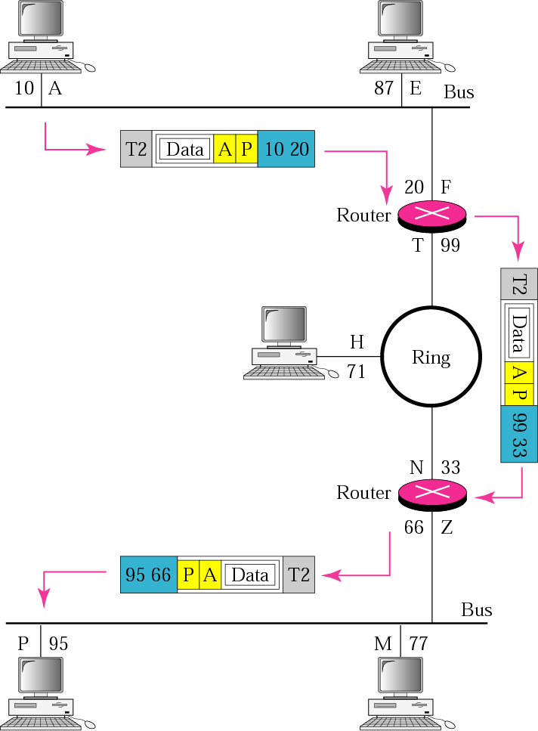
Figure 2.19 IP addresses
TCP/IP Protocol Suite

Slide 49
Example 4
As we will see in Chapter 4, an Internet address (in IPv4) is 32 bits in length, normally written as four decimal numbers, with each number representing 1 byte. The numbers are separated by a dot. Below is an example of such an address.
132.24.75.9
An internet address in IPv4 in decimal numbers
TCP/IP Protocol Suite

Slide 50
Example 5
Figure 2.20 shows an example of transport layer communication. Data coming from the upperlayers have port addresses j and k ( j is the address of the sending process, and k is the address of the receiving process). Since the data size is larger than the network layer can handle, the data are split into two packets, each packet retaining the service-point addresses ( j and k). Then in the network layer, network addresses (A and P) are added to each packet.
See Next Slide
TCP/IP Protocol Suite

Slide 51
Example 5 (Continued)
The packets can travel on different paths and arrive at the destination either in order or out of order. The two packets are delivered to the destination transport layer, which is responsible for removing the network layer headers and combining the two pieces of data for delivery to the upper layers.
See Next Slide
TCP/IP Protocol Suite

Slide 52
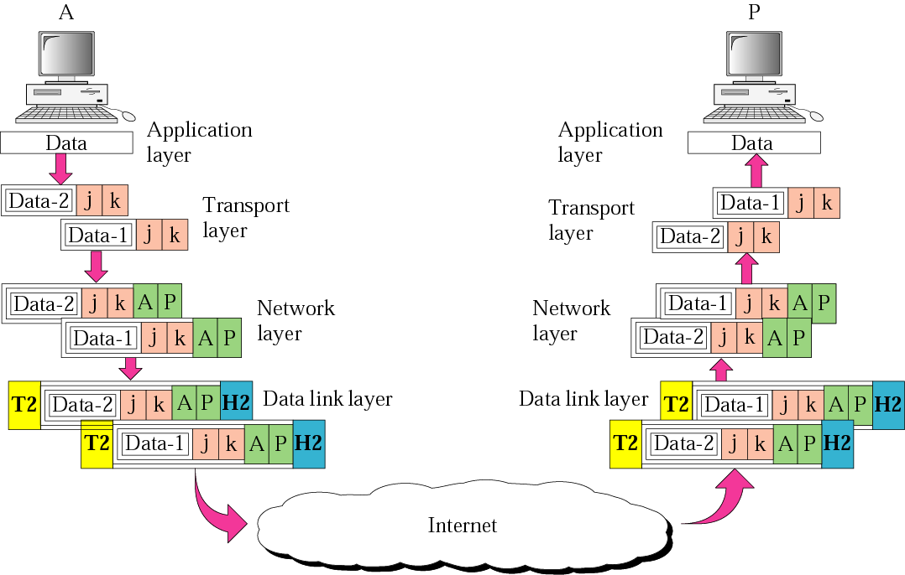
Figure 2.20 Port addresses
TCP/IP Protocol Suite

Slide 53
Example 6
As we will see in Chapters 11, 12, and 13, a port address is a 16-bit address represented by one decimal number as shown below.
753
A 16-bit port address represented as one single number.
TCP/IP Protocol Suite

Slide 54
TCP/IP Transport Layer
TCP and UDP introduce the concept of ports
Common ports and the services that run on them:
        FTP 21 and 20
        telnet 23
        SMTP 25
        http 80
        POP3 110

Slide 55
2.5 IP Versions
IP became the official protocol for the Internet in 1983. As the Internet has evolved, so has IP. There have been six versions since its inception. We look at the latter three versions here.
The topics discussed in this section include:
Version 4
Version 5
Version 6
TCP/IP Protocol Suite

